Slide 1

You and Your Avatar: XR for Meetings
Twitter: @debmayers24​
Website: http://debmayers.com
Sketchfab: https://sketchfab.com/debmayers24
Github: https://github.com/dmayers340

Slide 2
What’s Currently Wrong With Meetings?
Distractions
People do other work
No eye contact
Not engaging
No sense of presence
Delay
Can you hear me?
Hi all, <name> has joined
Little to no body language
Notes:
So what is currently wrong with meetings? Imagine the scenario, you’ve just dialled into your telepresence meeting, without video, and you announce you’ve joined the room, only to find that they’ve already started the meeting but you couldn’t tell because there is a 30 second delay on your phone. You present an idea at the meeting, but you cannot see the people, you cannot make eye contact and read their body language.
Any of that sound familiar? Really the biggest drawback of current ways of conducting meetings, over Skype, or the phone is just the lack of connection and presence with everyone in the meeting.

Slide 3
Stats
69% say they meetings are interrupted
27% have fallen asleep
13% have been ‘outed’ for taking a call in a place they should not be
40% drop off without announcing they’ve done so
59% of Employees are less effective and engaged
62% say meetings do not bring teams closer together
https://hbr.org/2014/08/what-people-are-really-doing-when-theyre-on-a-conference-call
https://smallbiztrends.com/2018/04/meeting-statistics.html
https://hbr.org/2017/07/stop-the-meeting-madness
Notes:
And just to add a few numbers

Slide 4
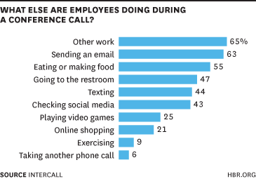
https://hbr.org/2014/08/what-people-are-really-doing-when-theyre-on-a-conference-call

Slide 5
Issues With XR Meetings
Still issues with non-verbal communication
Typing on a keyboard
Personal space
Latency
Avatars

Slide 6
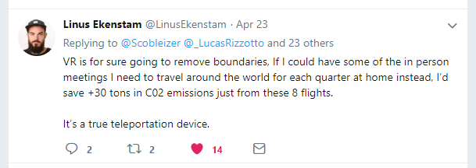
Advantages of XR Meetings
Everyone is focused
Sense of presence for distributed teams
Reduces cost
Reduces C02 footprint
Saves time
Increases memory retention
Experiences are treated as reality
Behaviour is impacted by virtual space

Slide 7
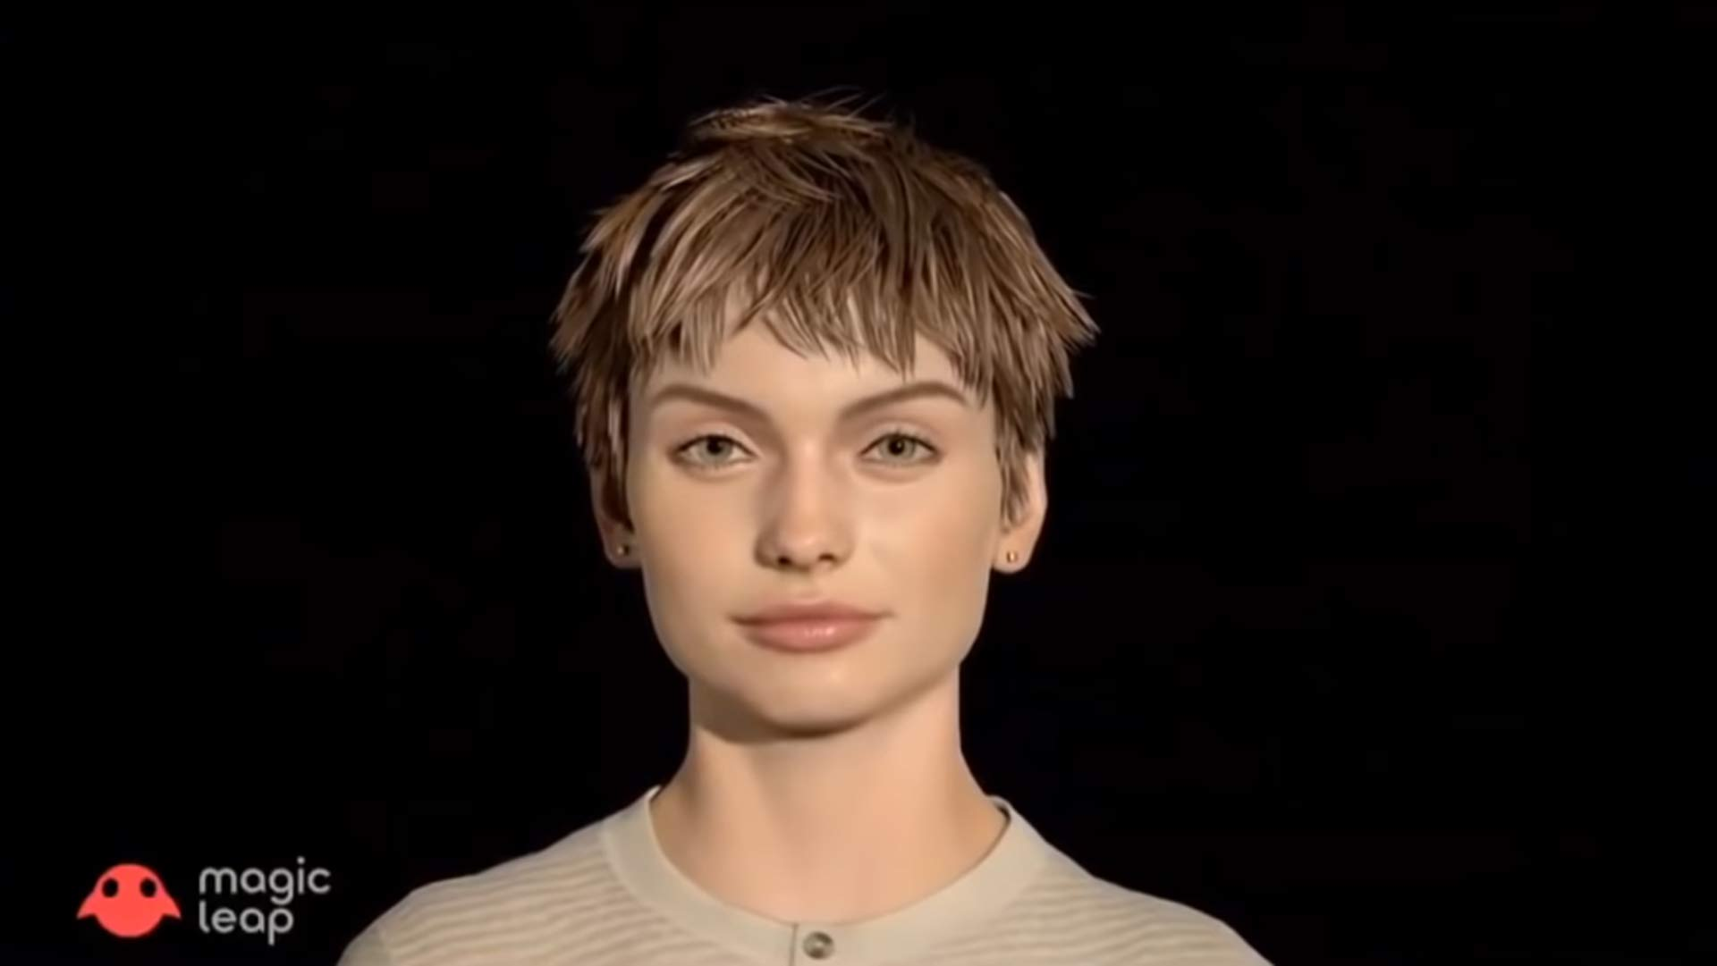
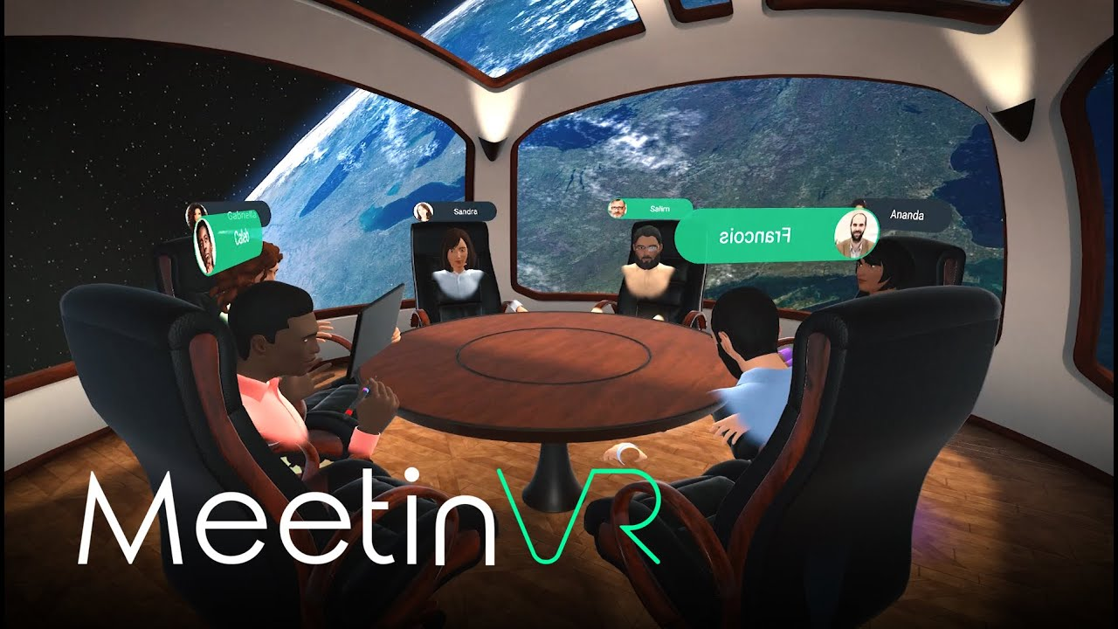
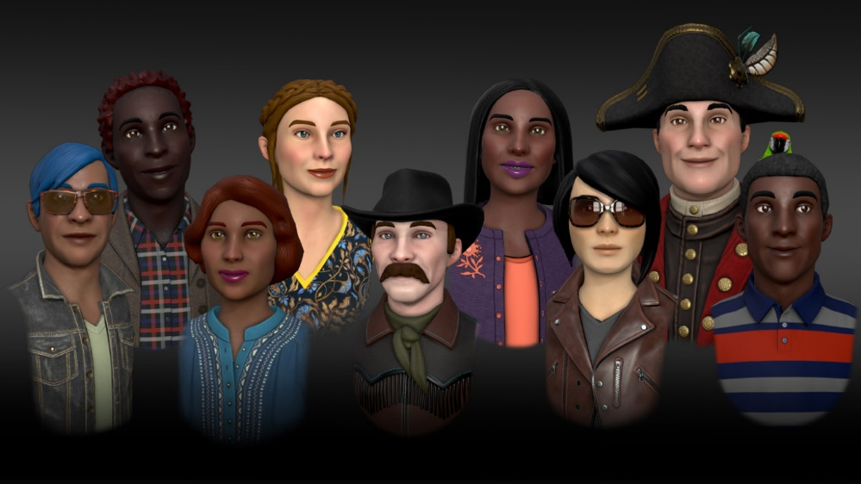
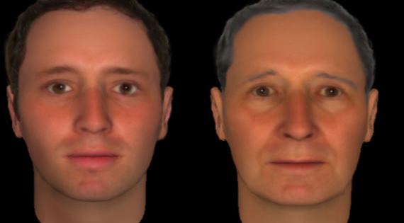
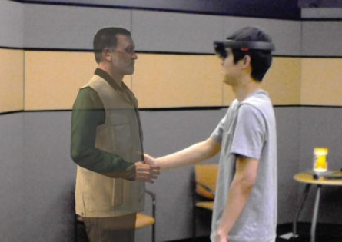
Avatars Are Not Professional

Slide 8
Skype/Phone/TP is Just Fine

Slide 9
I Don’t Want to Wear a Headset

Slide 10
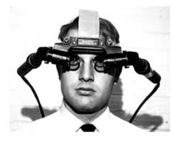
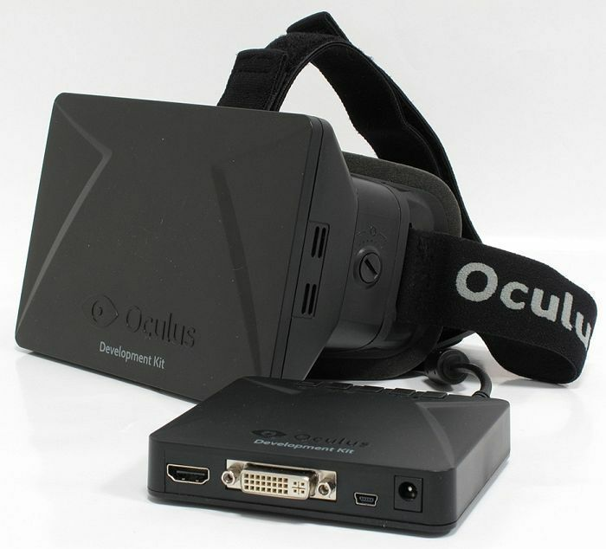
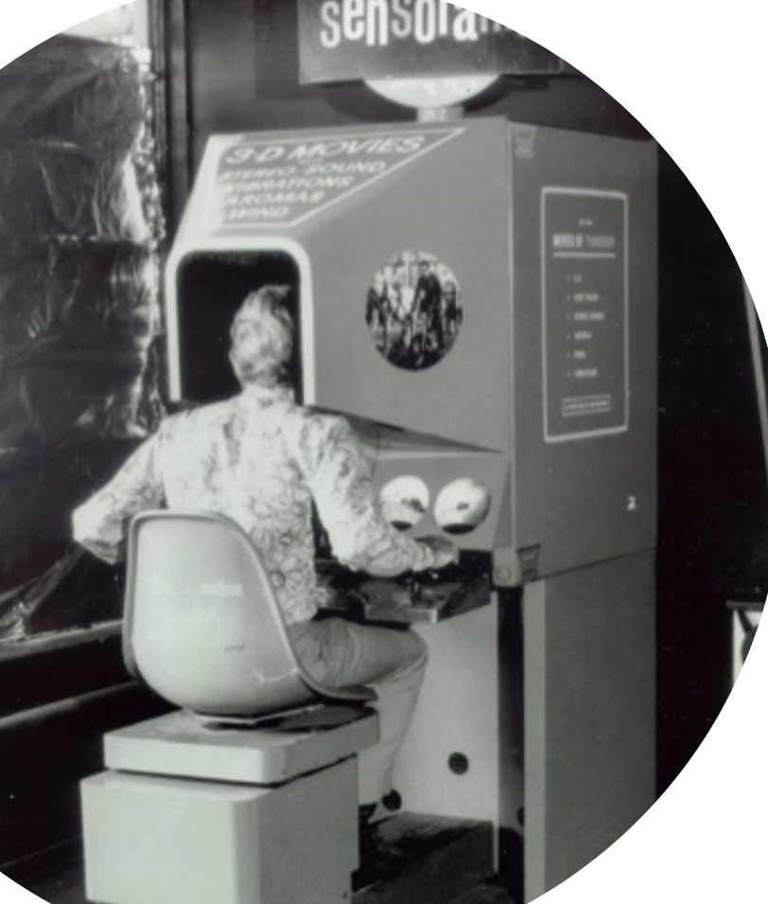
VR Progression 1950-2012

Slide 11
VR Makes Me Sick

Slide 12
Advantages of XR Meetings
Everyone is focused
Sense of presence for distributed teams
Reduces cost
Reduces C02 footprint
Saves time
Increases memory retention
Experiences are treated as reality
Behaviour is impacted by virtual space

Slide 13
You and Your Avatar: XR for Meetings
Twitter: @debmayers24​
Website: http://debmayers.com
Sketchfab: https://sketchfab.com/debmayers24
Github: https://github.com/dmayers340

